Slide 1
Implementing, testing and experimental analysis of 2 centrality concepts (betweenness and Eigen vector)
Mohit Jeste and Saloni Shah
Team #5
CSE 6331, Spring 2020
Emails: mohitsandeep.jeste@mavs.uta.edu, saloni.shah2@mavs.uta.edu
Submit as <team number-topic>.pptx on Canvas
Topic is one of GA, SP, MR, BC
Pictures of team members (optional)

Slide 2
Objectives achieved
Code for betweenness and eigen vector centrality.
Tested the code on all airline datasets provided.
Sanity check whether input file is in correct format.
Test cases check on:
Check that the first line is a string(name of the airline), the second and third line is an integer containing the number of vertices and edges respectively.
Check if the number of vertices following is equal to the number given on the second line.
Check that there is only one vertex per line.
Check if the number of edges following is equal to the number given on the third line.
Check format of an edge is correct i.e vertex1,vertex2,weight.
Check weight is greater than 0.
Check if the vertices present in input edges are present in the vertices given as input.

Slide 3
Discussion

Slide 4

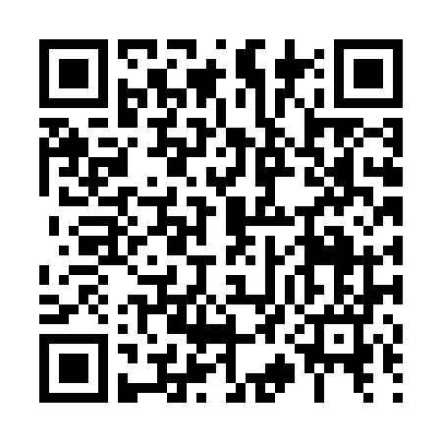
Thank You !!!
For more information visit:
http://itlab.uta.edu

